Slide 1

Digital Twins: Bridging the Physical and Digital Worlds
Transforming Industries with Virtual Replication
Created By: Dhruvin Patel (22BECE30255)
Rohang Shah (22BECE30424)
Yash Shah (22BECE30426)
Raj Prajapati (22BECE30283)
Class: 6-F
Purpose: Exploring the transformative potential of digital twins in various industries.

Slide 2


Introduction to Digital Twins
Definition: Digital twins are virtual models designed to accurately reflect physical objects, systems, or processes. They use real-time data to simulate performance and predict outcomes.
Historical Background: The term gained traction in 2002 through NASA’s virtual models for spacecraft, evolving to industry-wide use today.
Key Characteristics:
Interconnectivity via IoT sensors.
Predictive analysis capabilities.
Real-time decision support.
Significance: Bridges physical and digital
environments, enabling optimization and innovation across industries.

Slide 3
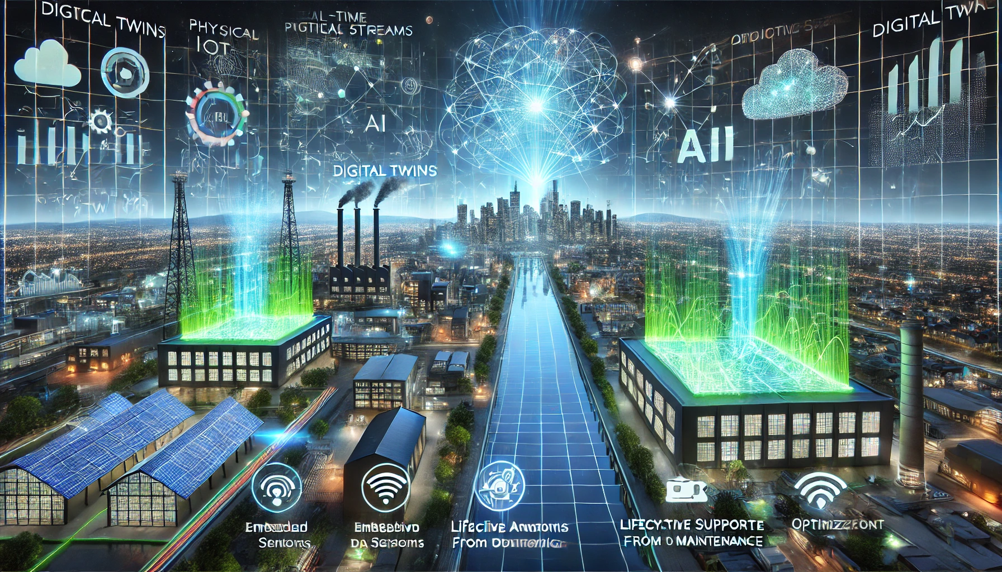
Core Concepts
Relationship Between Physical and Digital Worlds: Physical systems provide data; digital twins analyse and simulate for optimization.
IoT Integration: Real-time data from embedded
sensors creates a dynamic, up-to-date digital
replica.
Role of AI and Big Data: Advanced algorithms
analyze patterns, predict behaviors, and
suggest improvements.
Feedback Loops: Digital insights enhance the physical system’s efficiency and reliability.
Lifecycle Support: Digital twins cover design, operation, and maintenance phases of an asset.

Slide 4
How Digital Twins Work?
Data Capture: IoT devices gather detailed metrics from physical systems.
Communication: Real-time data is transmitted to cloud platforms for processing.
Model Creation: AI algorithms generate a virtual replica with dynamic updates.
Simulation and Analysis: Various scenarios are simulated to identify optimal solutions.
Operational Adjustments: Physical systems adapt based on insights and recommendations.
Continuous Improvement: The cycle repeats for enhanced precision and efficiency.

Slide 5
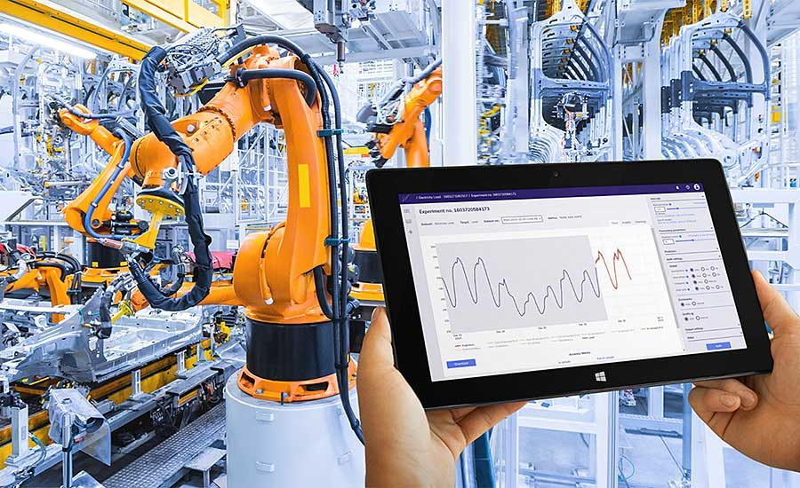
Applications in Manufacturing
Smart Factories: Real-time monitoring minimizes downtime and enhances productivity.
Supply Chain Management: Tracks every stage from raw materials to delivery, optimizing logistics.
Product Testing: Virtual prototypes test functionality,
durability, and user experience.
Use Case Example: Siemens employs digital twins for
predictive maintenance in manufacturing plants.
Impact: Enhanced efficiency, reduced costs, and improved customer satisfaction.

Slide 6

Applications in Healthcare
Personalized Healthcare: Digital replicas of organs simulate treatment outcomes tailored to individual patients.
Surgical Simulations: Virtual practice ensures precision
in complex operations.
Remote Monitoring: Digital twins analyze patient data
for early disease detection.
Case Example: Philips leverages digital twins for remote
patient monitoring and resource optimization in hospitals.
Potential: Revolutionizes diagnostics, treatment, and patient care management.

Slide 7
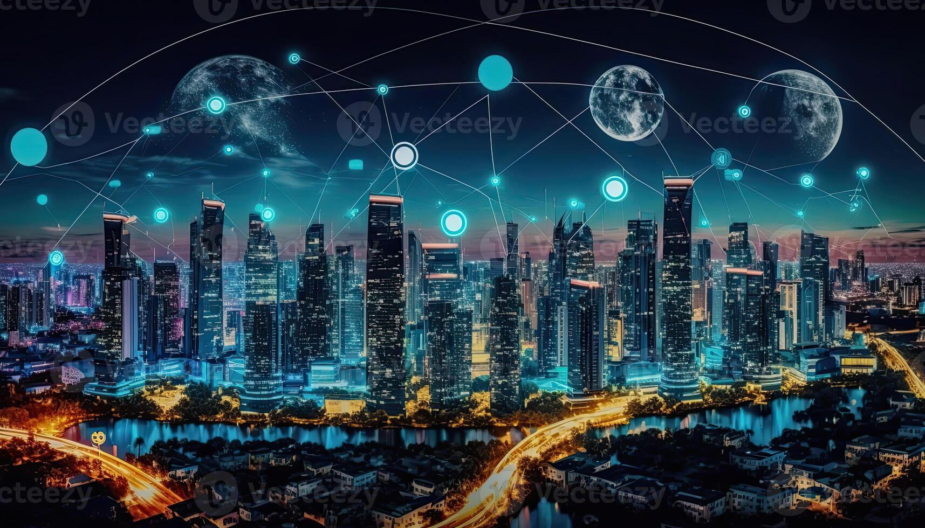
Applications in Smart Cities
Urban Planning: Simulates traffic flow, infrastructure needs, and disaster responses.
Energy Management: Predicts consumption patterns and optimizes energy distribution.
Public Safety: Monitors infrastructure health for
bridges, buildings, and roads.
Real-World Example: Singapore’s Virtual Singapore
project optimizes urban planning and resource allocation.
Advantages: Creates more livable, efficient, and sustainable cities.

Slide 8
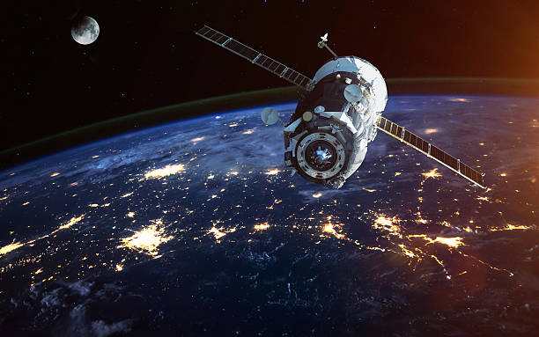
Applications in Aerospace
Aircraft Maintenance: Digital twins identify potential issues before they cause malfunctions.
Flight Optimization: Simulates flight conditions to improve fuel efficiency and safety.
Space Exploration: Models space mission scenarios for risk assessment and planning.
Example: NASA uses digital twins for the Mars rover program to simulate and control operations remotely.
Outcome: Increased safety, reliability, and mission success rates.

Slide 9
Role in Sustainability
Eco-friendly Designs: Digital twins minimize waste by optimizing resource usage.
Energy Efficiency: Simulates energy systems to reduce consumption and carbon footprints.
Recycling Initiatives: Tracks material lifecycles for circular economy models.
Renewable Energy: Wind farms and solar grids use digital twins for performance monitoring.
Case Example: Offshore wind farms employ digital twins for turbine optimization, enhancing sustainability.

Slide 10
Key Technologies Powering Digital Twins
Internet of Things (IoT): Connects physical assets to virtual systems via sensors.
Cloud Computing: Provides scalable data storage and analytics capabilities.
Artificial Intelligence (AI): Enables predictive insights and intelligent automation.
Edge Computing: Processes data locally for low-latency decision-making.
Digital Modeling Tools: Advanced 3D and simulation software enhance accuracy.
Big Data Analytics: Processes massive datasets for actionable insights.

Slide 11
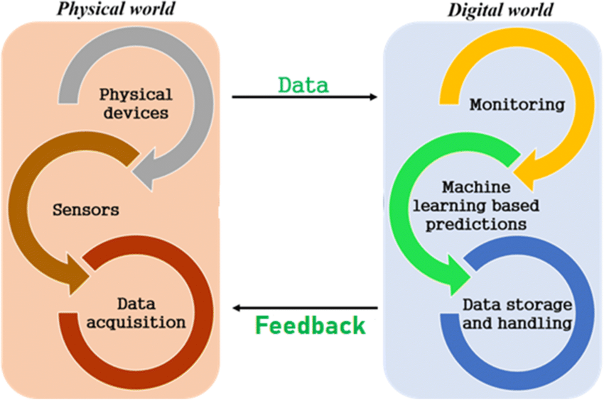
Advantages of Digital Twins
Operational Efficiency: Optimizes processes and reduces downtime.
Cost Savings: Preventive maintenance and optimized resource usage cut expenses.
Improved Decision-making: Real-time insights lead to
informed strategies.
Scalability: Applicable across industries from healthcare to
construction.
Customer Satisfaction: Enhances end-user experiences with
tailored solutions.
Innovation Catalyst: Drives new opportunities and breakthroughs.

Slide 12
Challenges and Limitations
High Costs: Initial investment in IoT infrastructure and expertise is significant.
Data Privacy: Protecting sensitive information from breaches remains challenging.
Complexity: Creating accurate simulations requires advanced technology and skilled professionals.
Integration Issues: Legacy systems often lack compatibility with digital twins.
Maintenance Needs: Continuous updates are required to ensure model accuracy.
Global Standards: Lack of uniformity in digital twin frameworks limits collaboration.

Slide 13
Future of Digital Twins
Human Digital Twins: Models of individuals could personalize medicine and wellness.
Smart Cities Expansion: Comprehensive urban models will optimize planning and sustainability.
AI Integration: Advanced machine learning will improve prediction accuracy.
Quantum Computing: Expands computational capacity for complex simulations.
Metaverse Collaboration: Digital twins could become integral to virtual environments.
Global Adoption: Increasing use in industries ranging from agriculture to entertainment.

Slide 14
Case Studies
Siemens: Digital twins monitor and optimize industrial processes in factories.
General Electric: Power plants use digital twins for predictive maintenance, reducing failures.
BMW: Virtual replicas streamline vehicle design and production testing.
NASA: Mission-critical digital twins simulate spacecraft for safety and efficiency.
Virtual Singapore: A comprehensive urban twin for optimizing city planning and management.

Slide 15
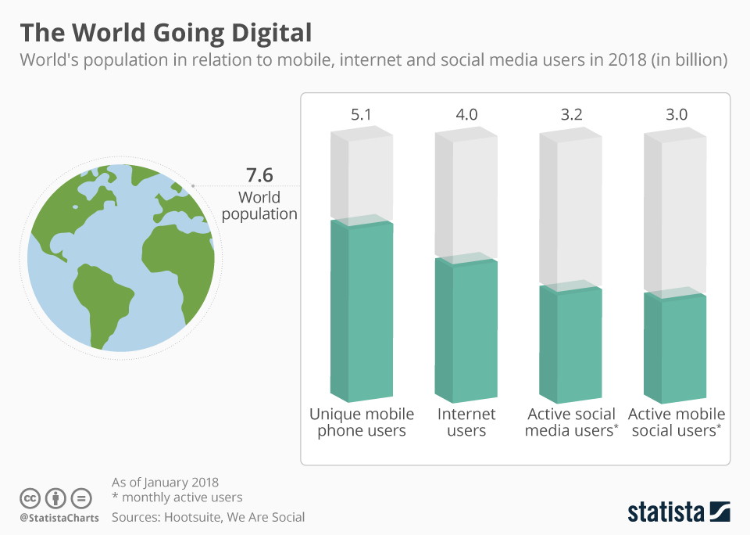
Conclusion
Summary: Digital twins integrate physical and digital environments, transforming operations and decision-making.
Potential Impact: Unlocks innovation across healthcare, aerospace, manufacturing, and more.
Call to Action: Embrace digital twin technology to lead the next wave of digital transformation.

